Slide 1

OMGT1039
Operations Management
Week 6
Inventory Management

Slide 2
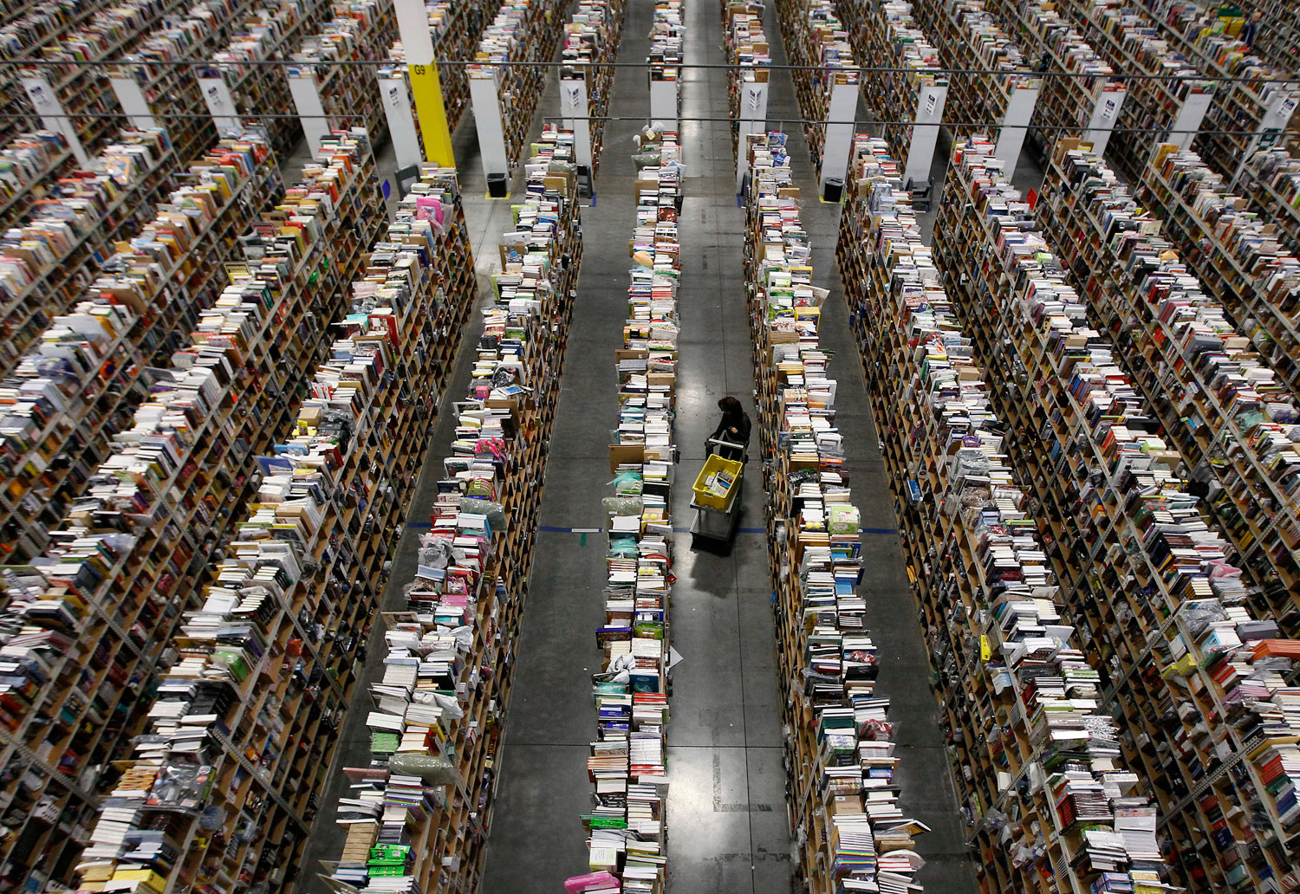
OMGT1039
Operations Management
Week 7
Inventory Management

Slide 3
COMMONWEALTH OF AUSTRALIA
Copyright Regulations 1969
WARNING
This material has been reproduced and communicated
to you by or on behalf of Royal Melbourne Institute
of Technology, (RMIT University) pursuant to Part
VB of the Copyright Act 1968 (the Act).
The material in this communication may be subject to
copyright under the Act. Any further reproduction or
communication of this material by you may be the
subject of copyright protection under the Act.
Do not remove this notice.
First page of scanned document
This presentation includes selected slides from
William J Stevenson (2015) Operations Management, 12 ed. ISBN 10: 1259580091, McGraw Hill

Slide 4
Learning Objectives
  Define the term inventory
  List the different types of inventory
  Describe the main functions of inventory
  Discuss the main requirements for effective management
  Describe the costs that are relevant for inventory management
  Describe the A-B-C approach and explain how it is useful
  Describe the basic Economic Order Quantity (EOQ) model and its assumptions and solve typical problems
  Describe the economic production quantity model and solve typical problems
  Describe reorder point models and solve typical problems

Slide 5
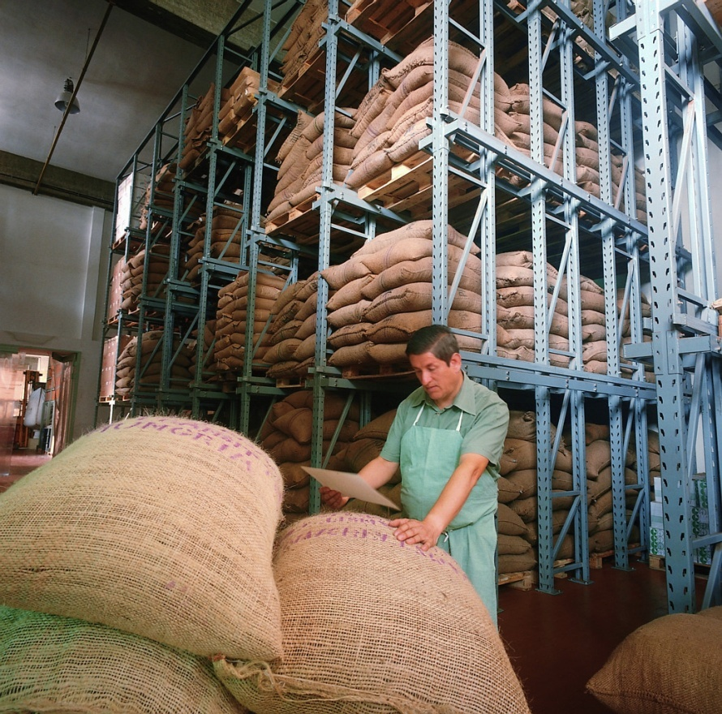
Inventory
Inventory
  A stock or store of goods
Independent demand items
  Items that are ready to be sold or used
Inventories are a vital part of business: (1) necessary for operations and (2) contribute to customer satisfaction
  A “typical” firm has roughly 30% of its current assets and as much as 90% of its working capital invested in inventory

Slide 6
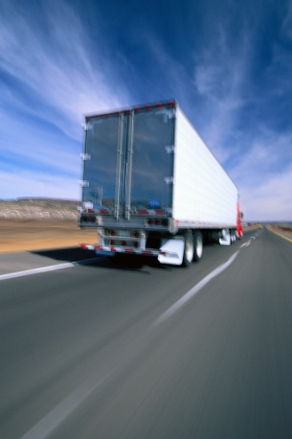

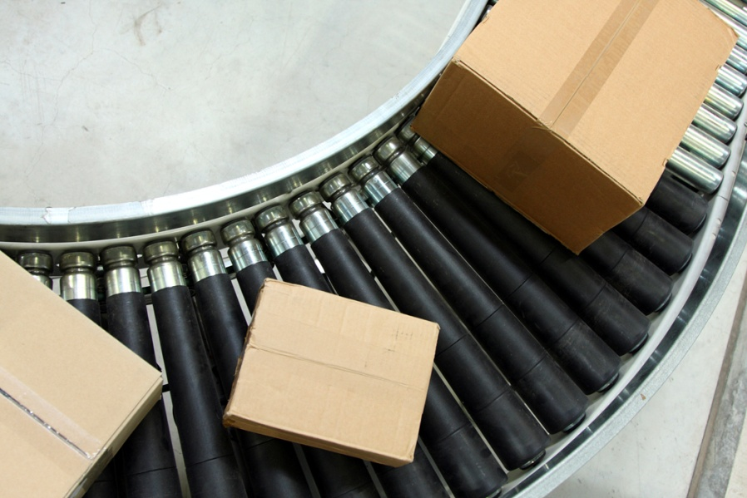
Types of Inventory
Raw materials and purchased parts
Work-in-process (WIP)
Finished goods inventories or merchandise
Tools and supplies
Maintenance and repairs (MRO) inventory
Goods-in-transit to warehouses or customers (pipeline inventory)

Slide 7
Inventory Functions
Inventories serve a number of functions such as:
  To meet anticipated customer demand
  To smooth production requirements
  To decouple operations
  To protect against stockouts
  To take advantage of order cycles
  To hedge against price increases
  To permit operations
  To take advantage of quantity discounts
  Any Disadvantage?

Slide 8
Objectives of Inventory Control
Inventory management has two main concerns:
  Level of customer service
    Having the right goods available in the right quantity in the right place at the right time
  Costs of ordering and carrying inventories
    The overall objective of inventory management is to achieve satisfactory levels of customer service while keeping inventory costs within reasonable bounds

Slide 9
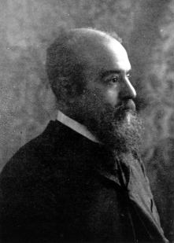
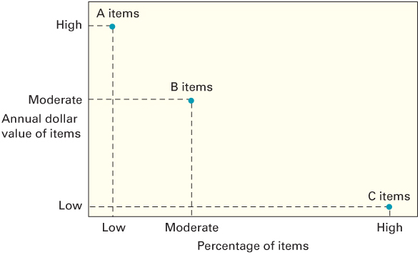
ABC Classification System
A-B-C approach
  Classifying inventory according to some measure of importance, and allocating control efforts accordingly
  A items (very important)
    10 to 20 percent of the number of items in inventory and about 60 to 70 percent of the annual dollar value
  B items (moderately important)
  C items (least important)
    50 to 60 percent of the number
    of items in inventory but only
    about 10 to 15 percent of the
    annual dollar value
Vilfredo Pareto

Slide 10
Inventory Costs
Purchase cost
  The amount paid to buy the inventory
Holding (carrying) costs
  Cost to carry an item in inventory for a length of time, usually a year
Ordering costs
  Costs of ordering and receiving inventory
Setup costs
  The costs involved in preparing equipment for a job
  Analogous to ordering costs
Shortage costs
  Costs resulting when demand exceeds the supply of inventory; often unrealized profit per unit

Slide 11
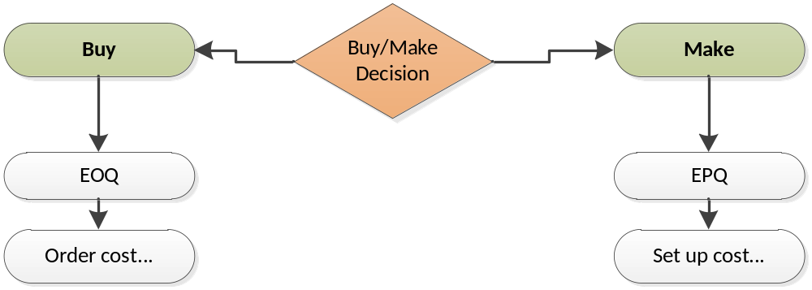
Make or Buy Decision

Slide 12
How Much to Order: Economic Order Quantity (EOQ) Models
Economic order quantity models identify the optimal order quantity by minimizing the sum of annual costs that vary with order size and frequency
The basic EOQ model is used to find a fixed order quantity that will minimize total annual inventory costs
Assumptions:
  Only one product is involved
  Annual demand requirements are known
  Demand is even throughout the year
  Lead time does not vary
  Each order is received in a single delivery
  There are no quantity discounts

Slide 13
The Inventory Cycle
Profile of Inventory Level Over Time
Q
Usage
rate
Quantity
on hand
Reorder
point
Time
Receive
order
Place
order
Receive
order
Place
order
Receive
order
Lead time

Slide 14
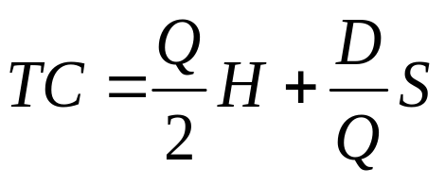
Goal: Total Cost Minimization
The Total-Cost Curve is U-Shaped
Annual Cost
Holding Costs
Ordering Costs
Order Quantity (Q)
Q_{O}
(optimal order quantity)

Slide 15
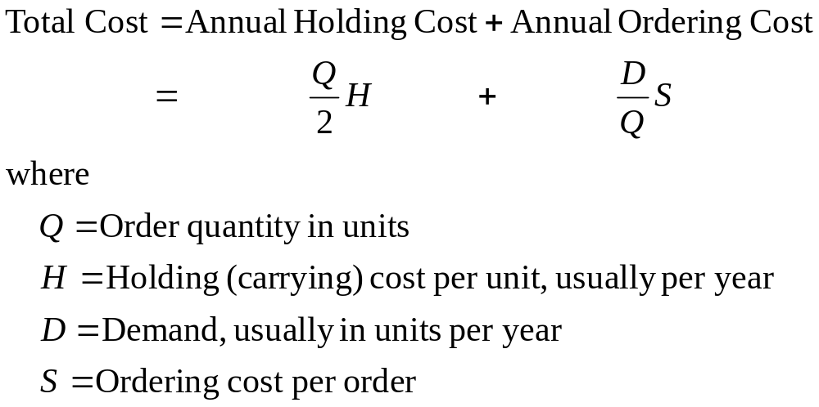
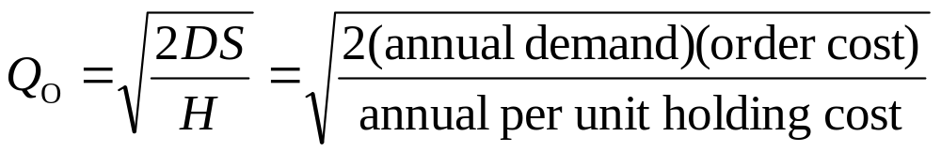
Total Annual Cost
Economic Order Quantity

Slide 16
EOQ Example
A local distributor for a national tire company expects to sell approximately 9,600 steel-belted radial tires of a certain size and tread design next year. Annual carrying cost is $16 per tire, and ordering cost is $75.
a. What is the EOQ?
b. What is the total annual cost if the EOQ quantity is ordered?
Solution:
D = 9,600 tires per year
H = $16 per unit per year
S = $75

Slide 17
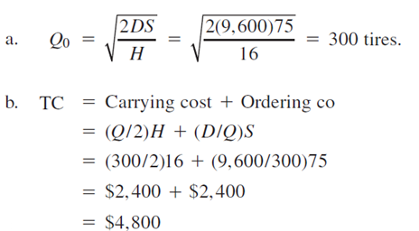
EOQ Example

Slide 18
How Much to Make: Economic Production Quantity (EPQ)
The batch mode is widely used in production. In certain instances, the capacity to produce a part exceeds its usage (demand rate)
  Assumptions
    Only one item is involved
    Annual demand requirements are known
    Usage rate is constant
    Usage occurs continually, but production occurs periodically
    The production rate is constant
    Lead time does not vary
    There are no quantity discounts

Slide 19
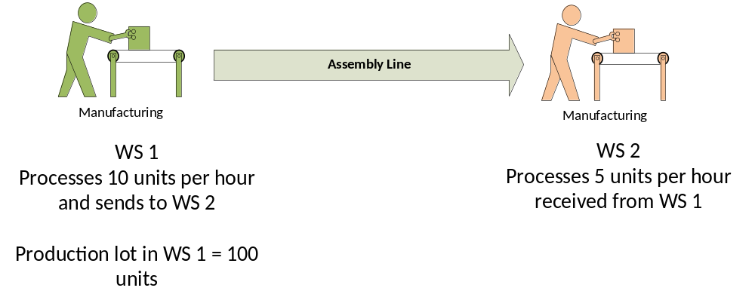
EPQ: Inventory Profile
Q
Production
and usage
Usage
only
Production
and usage
Usage
only
Production
and usage
Q_{p}
Cumulative
production
I_{max}
Amount
on hand
Time

Slide 20
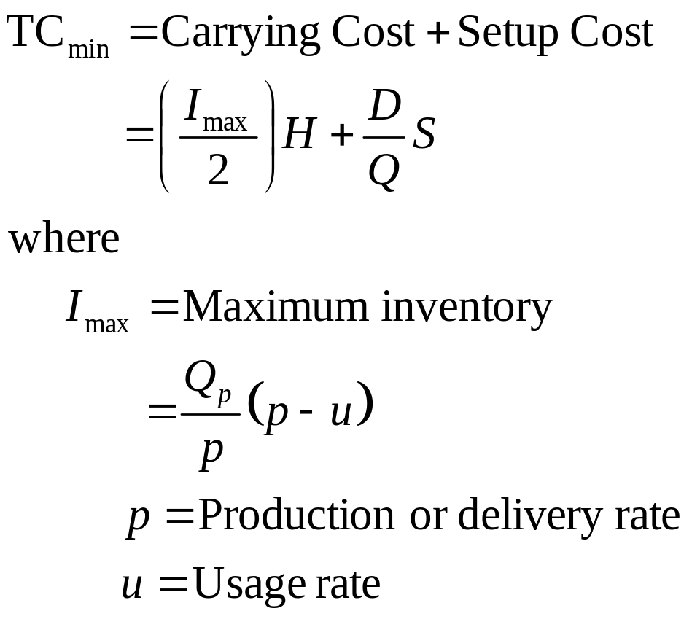
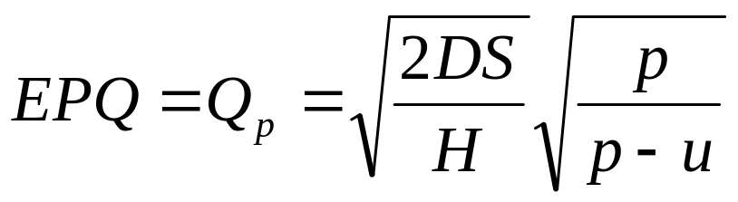
EPQ – Total Cost

Slide 21
EPQ Example
A toy manufacturer uses 48,000 rubber wheels per year for its popular dump truck series. The firm makes its own wheels, which it can produce at a rate of 800 per day. The toy trucks are assembled uniformly over the entire year. Carrying cost is $1 per wheel a year. Setup cost for a production run of wheels is $45. The firm operates 240 days per year.
Determine the:
a. Optimal run size.
b. Minimum total annual cost for carrying and setup.
c. Cycle time for the optimal run size.
d. Run time.
Solution:
D = 48,000 wheels per year; S = $45; H = $1 per wheel per year
P = 800 wheels per day; U = 48,000 wheels per 240 days, or 200 wheels per day

Slide 22
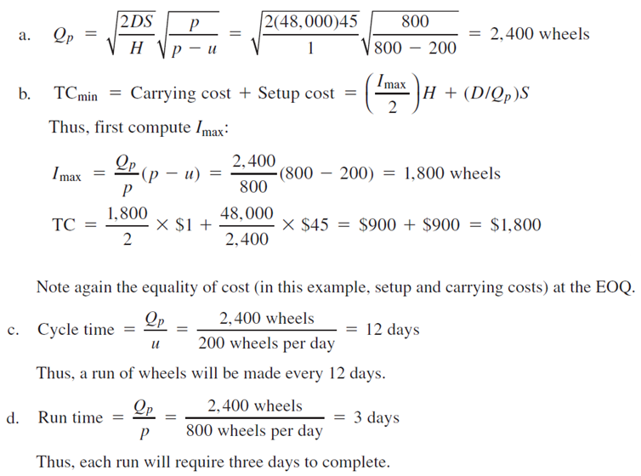
EPQ Example

Slide 23
When to Reorder
Reorder point
  When the quantity on hand of an item drops to this amount, the item is reordered.
  Determinants of the reorder point
    The rate of demand
    The lead time
    The extent of demand and/or lead time variability
    The degree of stockout risk acceptable to management

Slide 24
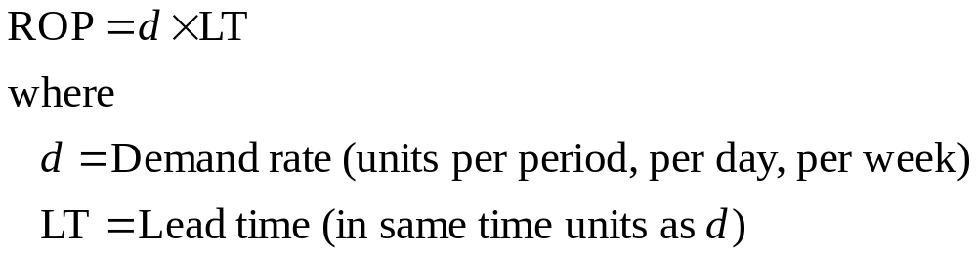
Reorder Point: Under Certainty

Slide 25
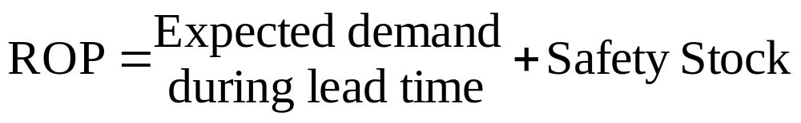
Reorder Point: Under Uncertainty
Demand or lead time uncertainty creates the possibility that demand will be greater than available supply
To reduce the likelihood of a stockout, it becomes necessary to carry safety stock
  Safety stock
    Stock that is held in excess of expected demand due to variable demand and/or lead time

Slide 26
Safety Stock?
As the amount of safety stock carried increases, the risk of stockout decreases.
  This improves customer service level
Service level
  The probability that demand will not exceed supply during lead time
  Service level = 100% - Stockout risk

Slide 27
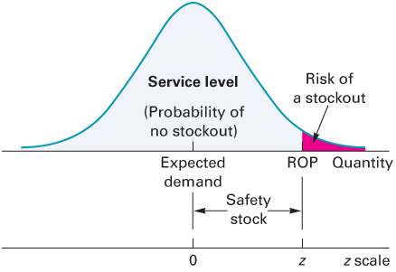
Reorder Point
The ROP based on a normal
Distribution of lead time demand

Slide 28
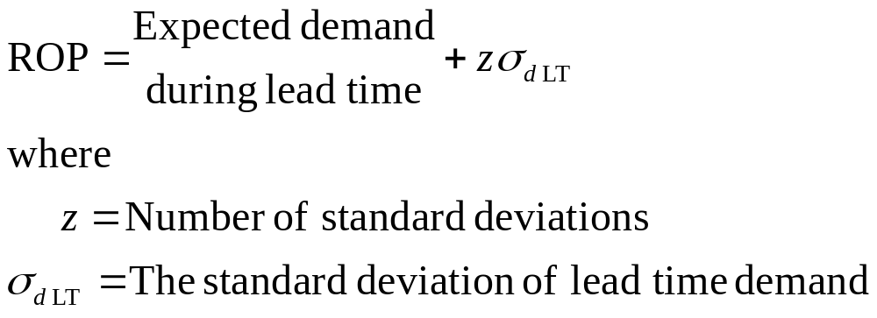
How Much Safety Stock?
The amount of safety stock that is appropriate for a given situation depends upon:
  The average demand rate and average lead time
  Demand and lead time variability
  The desired service level

Slide 29
ROP Example
Suppose that the manager of a construction supply house determined from historical records that demand for sand follows a normal distribution. In addition, suppose the manager determined that demand during lead time could be described by a normal distribution that has a mean of 50 tons and a standard deviation of 5 tons. Answer these questions, assuming that the manager is willing to accept a stock-out risk of no more than 3 percent:
a. What value of z is appropriate?
b. How much safety stock should be held?
c. What reorder point should be used?

Slide 30
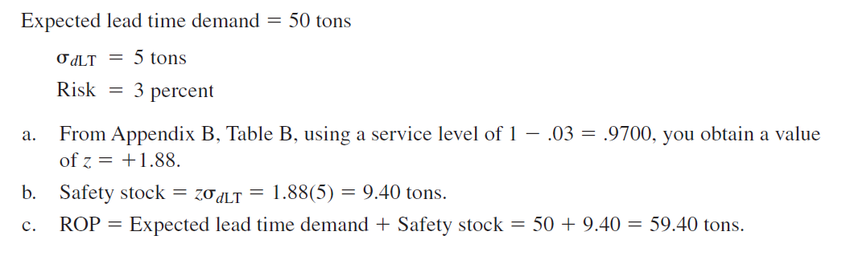
ROP Example

Slide 31
Question

